Slide 1

GI (travel) X-Sell EDA - KEY

Slide 2
Key discovery
Notes:
Time Range
Pre-Covid: Jan 2017 - Feb 2020
Covid: Mar 2020 – Jun 2022
Post-Covid Jun 2022 - Now
Channel
Other: Citi and JLT
AXA Direct has an increasing coverage % during covid, yet HSBC still has the highest number of clients who bought new policies during Covid.
Life Agents shared % has reached the top at 2020, during the covid 19, Life Agents have more impact on customers during covid.
The travel duration for single trip is higher during covid.
The age group with the most number for each channel for each year increased during covid, that means the Age of people going to travel gets older during Covid.
Female always tends to buy travel insurance then Male in any case. Females are always more aware of insurance then Male.

Slide 3
Percentage of customers who buy LH after claimed in travel is significantly higher than not claimed in travel. Except for HSBC, maybe due to lack of agent/claim experience?
Number of claim drops a lot after covid, but the claim rate increased. More accident during covid?
Among those travel customers, 83% haven’t bought any LH products.
Generally, more clients are buying L&H through the year according to submit year of LH application, except for 2018 has a slight drop.
Since around 2012, the Age group of first-time-buying-LH has most increased in the age group of 17-30, more young people are gaining more awareness on LH insurance products.
Most people first buy L&H product at the age 18,22-26,29-30
The average annual premium of traditional life(pink) has increased drastically from 2018.
Medical(red) increased while critical illness(blue) decreased. Seems more ppl are buying medical instead of CI.
The number of policy of medical product is the largest while traditional life is the most profitable product compare both Total .
Age group of 51-60 has pay more premium in average in 2020, and return to previous level afterwards.

Slide 4

Data Sources in detail
Info should have:
Data Sources
Description
Range
# of Rows & columns
Consolidated dataset(s)
Merging methods (e.g. on what?)
Use for…
Etc.
Basestat:
min OCCDATE: 1998-01-01 max OCCDATE: 2023-05-22 min CCDATE: 1999-05-01
max CCDATE: 2023-12-23
Shape of base_df: (5257817, 116)
Number of unique client: 1503225
Client data:
min START_DATE: 1900-01-01
Shape of client_data_df: (6139950, 11)
Number of unique client: 6139950
Clambase:
min DATREP: 1998-12-08
max DATREP: 2023-02-23
Shape of clambase_df: (237406, 364)
useful_base_df.merge(useful_client_data_df, left_on="COWNNUM", right_on='CLNTNUM' ,how="left")
Base_LH_df
=pd.merge(F_usefull_BCC, useful_LH, how="left", left_on="modified_SECUITYNO", right_on="modified_owner_id")
LH_DATA:
min submit date: 2002-01-02 00:00:00
max submit date: 2023-03-16 00:00:00
useful_LH shape: (1941148, 15)
Base_LH_df
Useful_BCC=
pd.merge(useful_base_w_client_df, useful_clambase_drop_not_in_usefulbase, on=['contrnb'], how='left')

Slide 5
Conditions for potential LH customers
Has_Claim> '2020-01-01’ &
sex== “F” &
has_bought_LH == False &
["age_gp"] =="2. Age 17 - 30" or
["age_gp"] =="3. Age 31 - 40“
For the above condition:
2374 unique travel customers can be potential LH customers.

Slide 6
Based on Channels

Slide 7
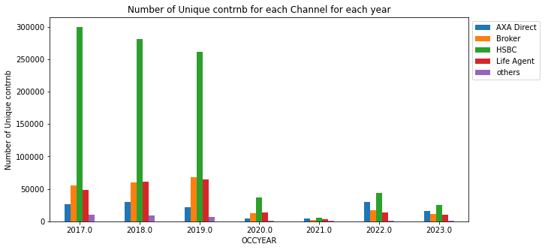
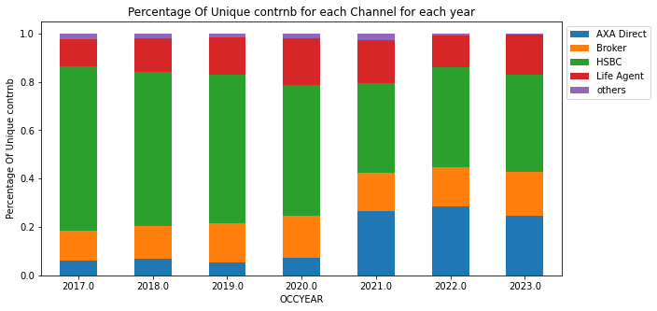
Number of new policies(contract number) at that year
There is a huge drop in 2020 due to covid.
AXA Direct(Blue) has an increasing coverage % during 2021-2022, yet HSBC still has the highest number of clients who bought new policies between 2020-2022.
Remark : Check use the most updated data.
Already checked
Notes:
Channel
Other: Citi and JLT

Slide 8
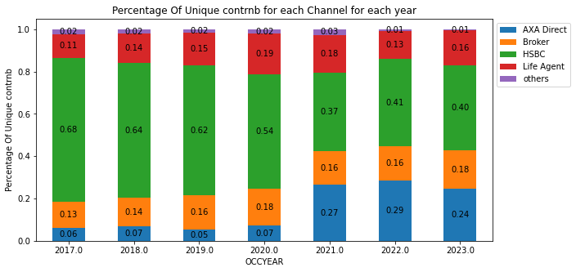
Additional Modified slides

Slide 9
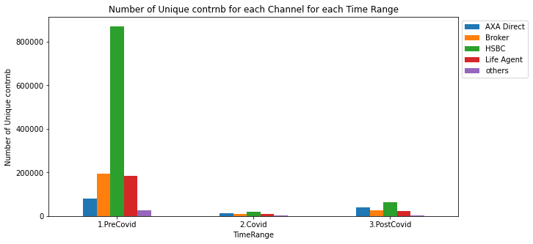
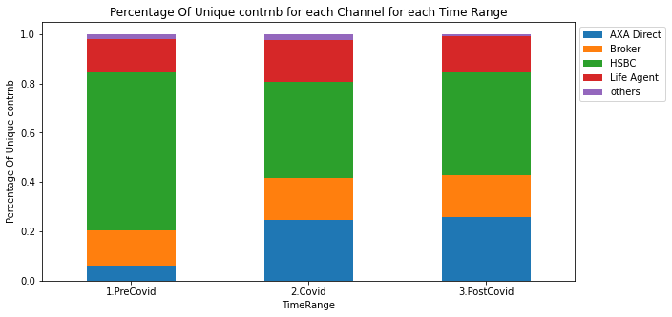
Number of new policies bought at different period
There is a huge drop during Covid
AXA Direct has an increasing coverage % during covid, yet HSBC still has the highest number of clients who bought new policies during Covid.
Notes:
Time Range
Pre-Covid: Jan 2017 - Feb 2020
Covid: Mar 2020 – Jun 2022
Post-Covid Jun 2022 - Now
Channel
Other: Citi and JLT

Slide 10
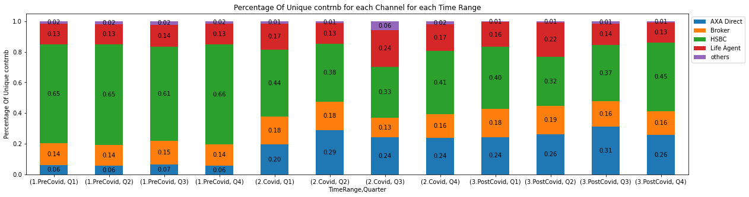
Additional Modified slides

Slide 11
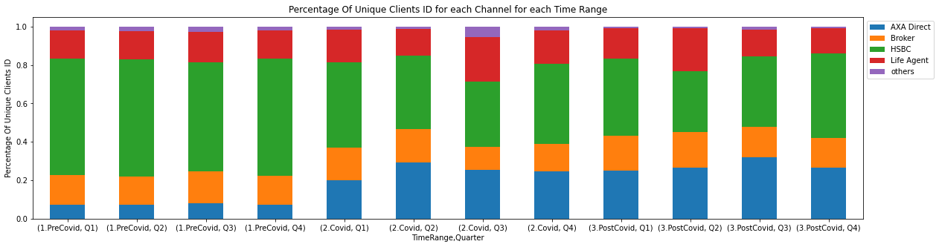

Additional Modified slides

Slide 12

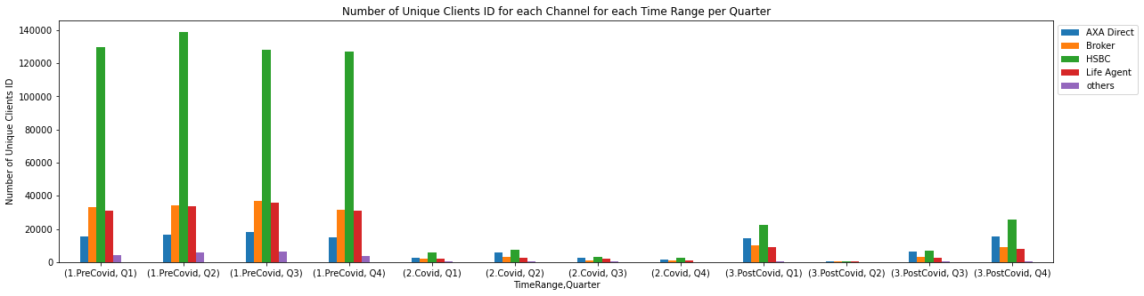
Additional Modified slides

Slide 13
New Policies by channel per year
HSBC has decreased it’s % coverage
Direct sells has increased its % coverage
Broker’s percentage has no significant change
Life Agents has reached the top at 2020, during the covid 19
Life Agents have more impact on customers during covid

Slide 14
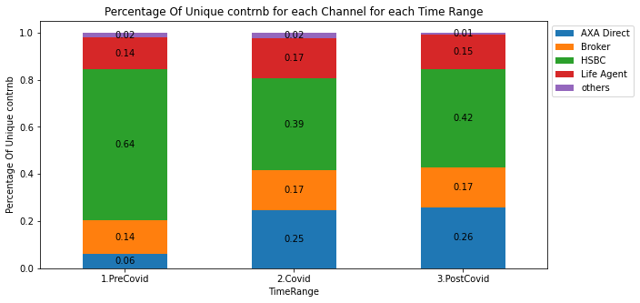
Additional Modified slides

Slide 15
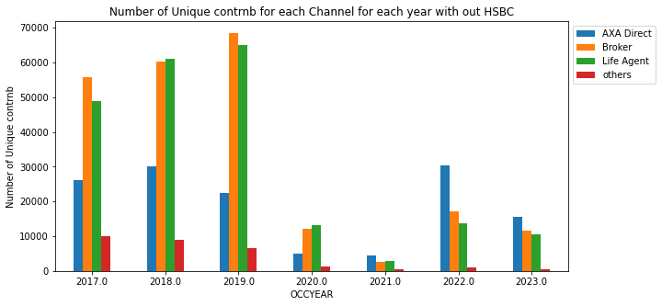
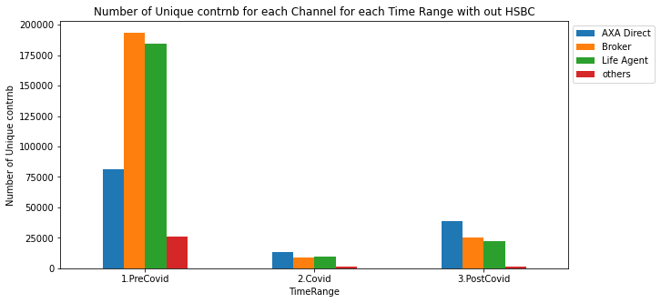

Slide 16
Based on products

Slide 17
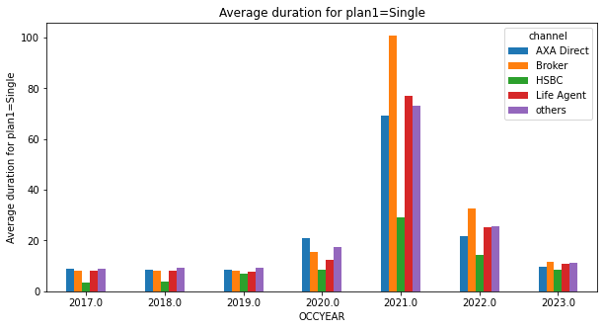
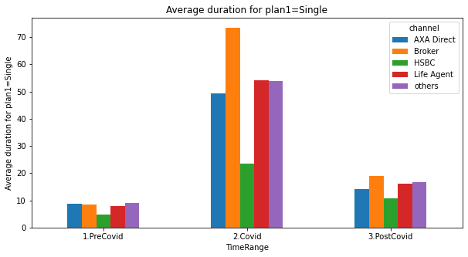
Travel Duration for Single Trip
The travel duration for single trip is the highest during covid

Slide 18
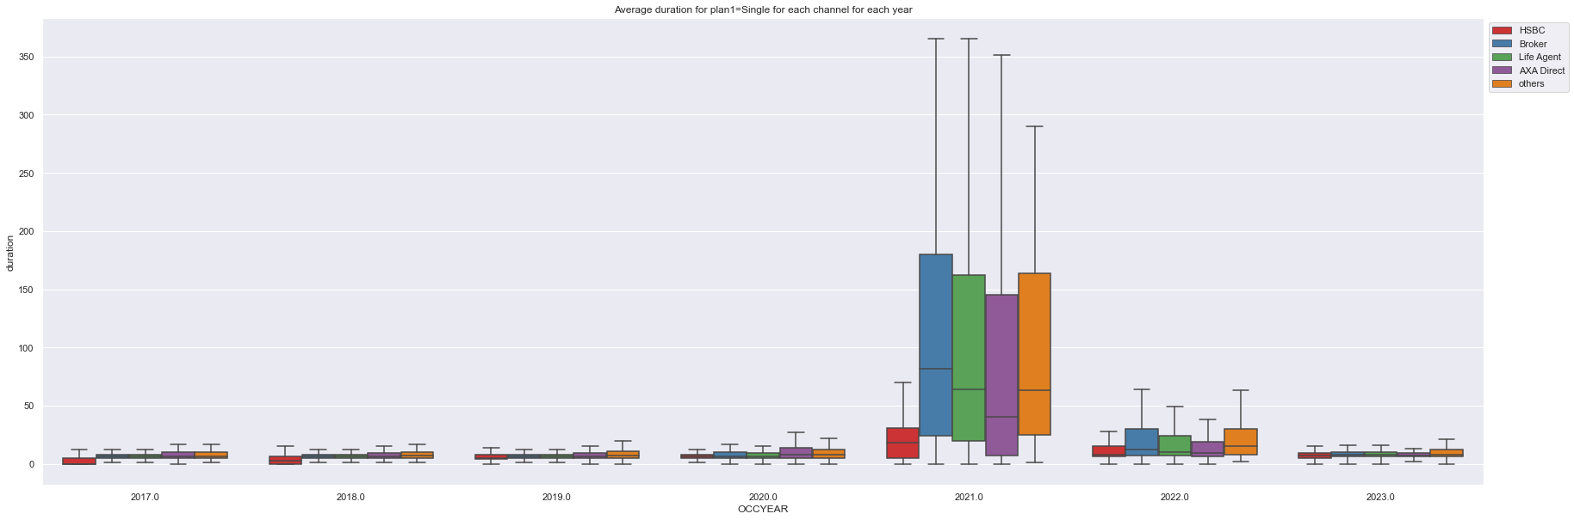
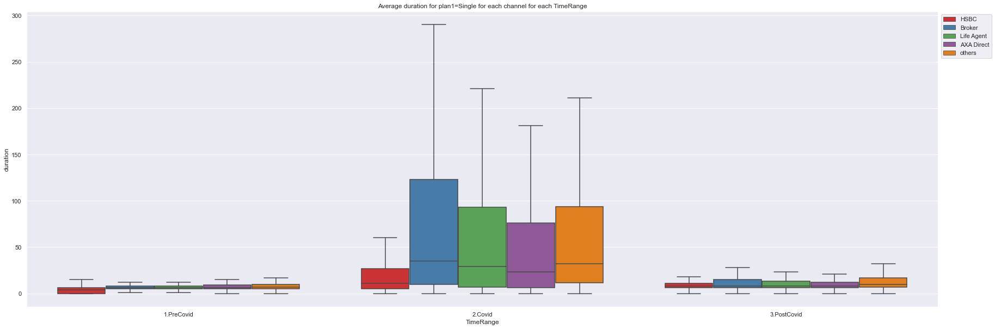
Additional Modified slides

Slide 19
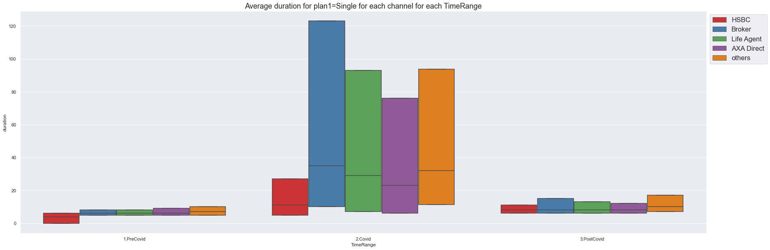
Additional Modified slides

Slide 20
Based on age

Slide 21
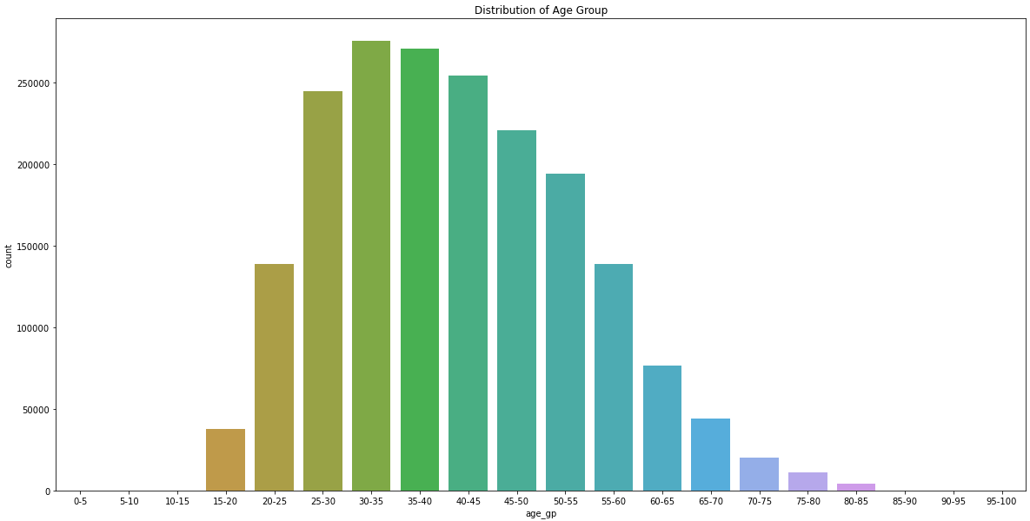
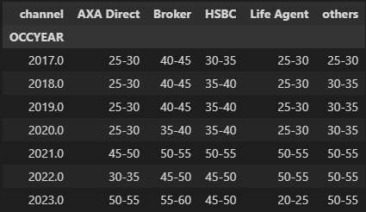
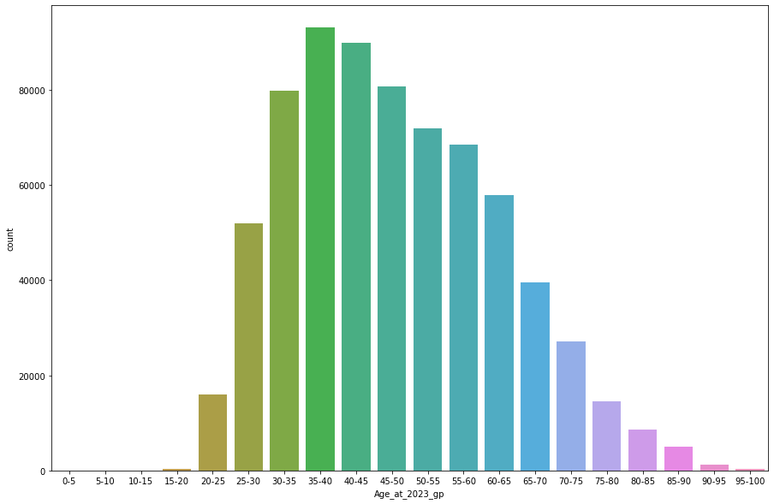
Age Distribution At the year of buying travel
The most popular age_gp for each channel for each year
The age group tends to get older , that means the
Age of people going to travel gets older during
Covid.

Slide 22
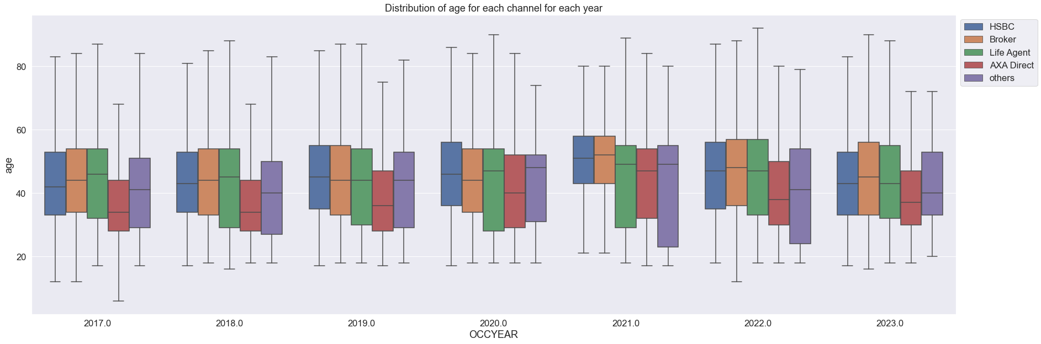
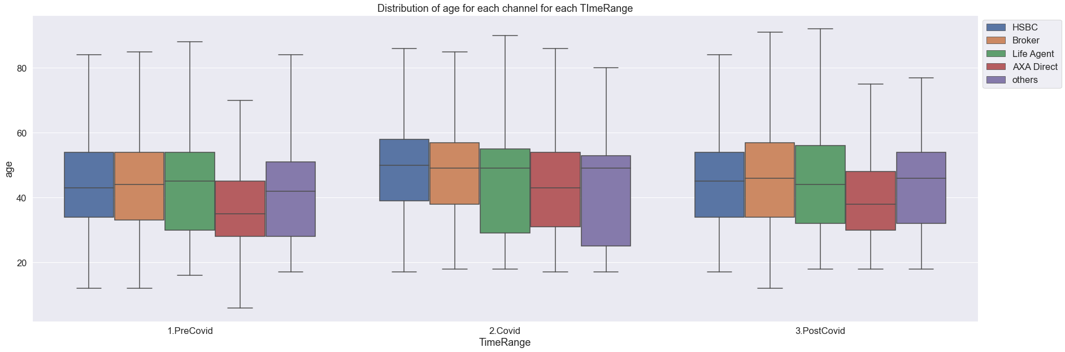
Additional Modified slides

Slide 23
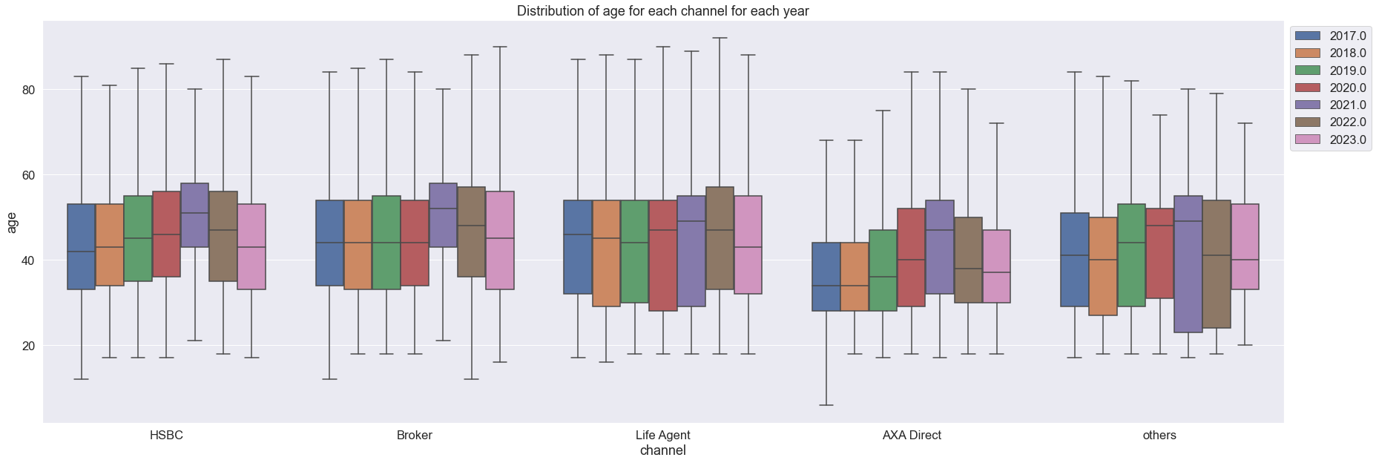
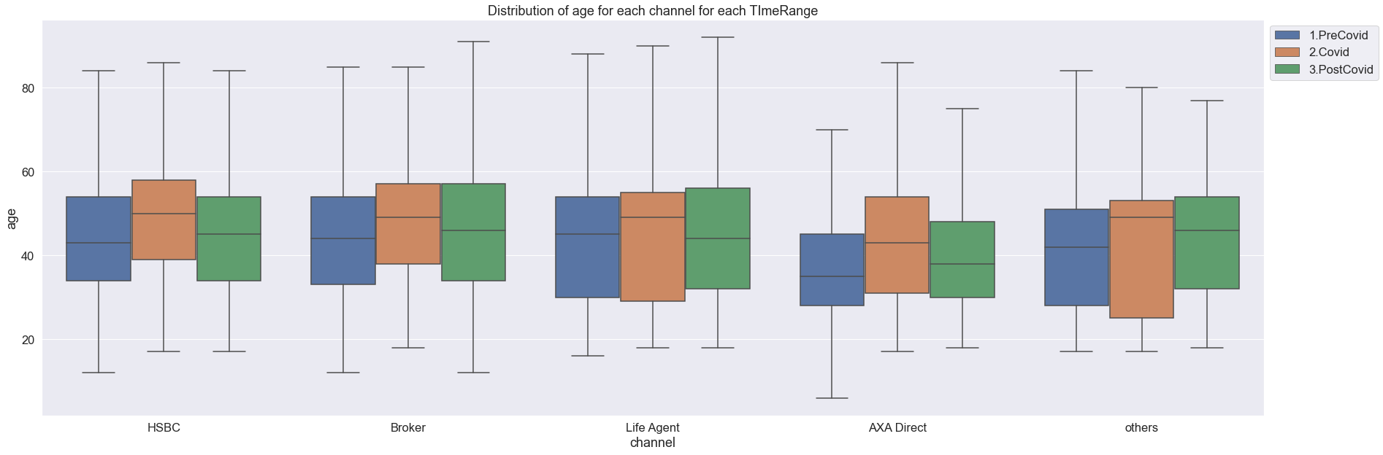
Additional Modified slides

Slide 24
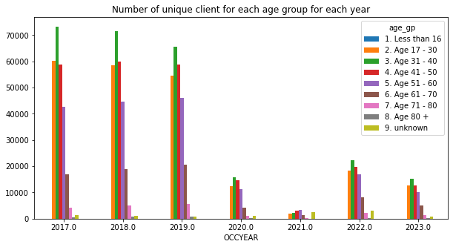
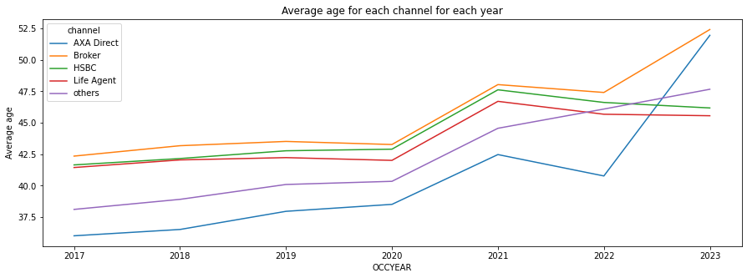
Age group
During Covid, the green bar (31-40) decreased.
While the red(41-50)and purple(51-60) increased.

Slide 25
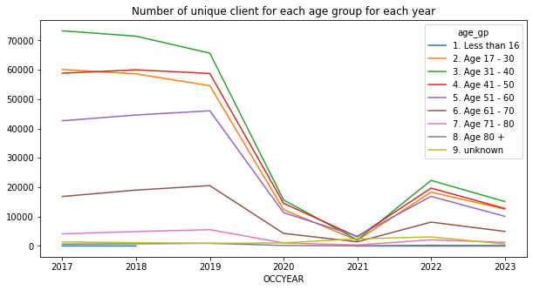
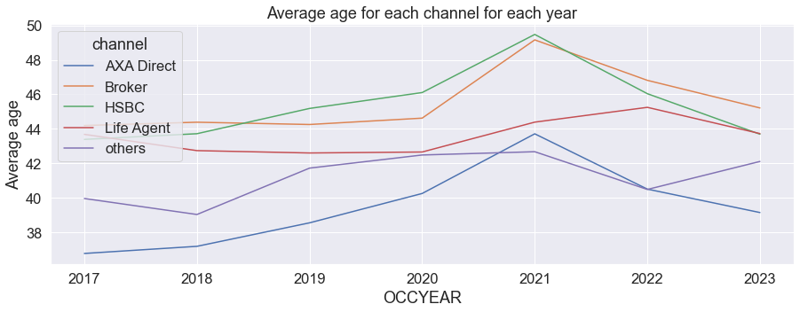
Additional Modified slides

Slide 26
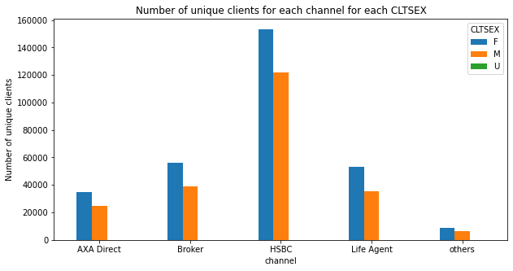
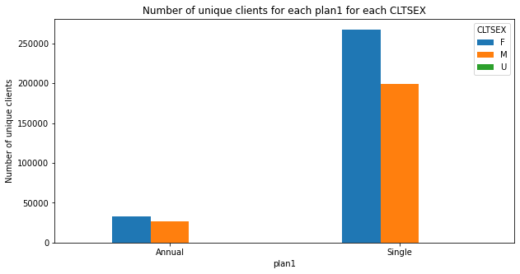
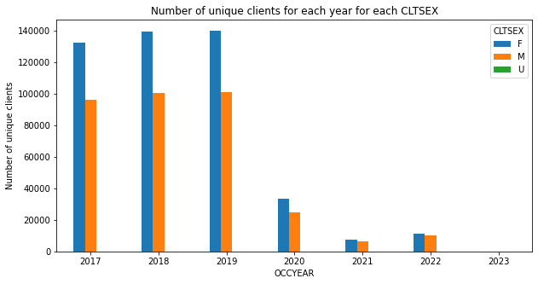
Gender
Female always tends to buy travel insurance then Male
Overall Gender Percentage:
F 321073 47%
M 251182 36%
Nan 115156 17%
U 980 0.1%

Slide 27
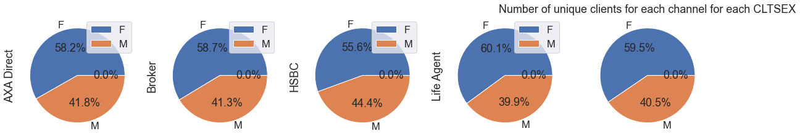
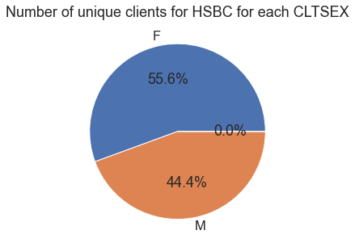
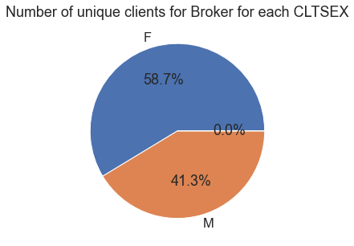
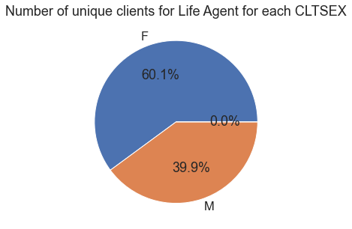

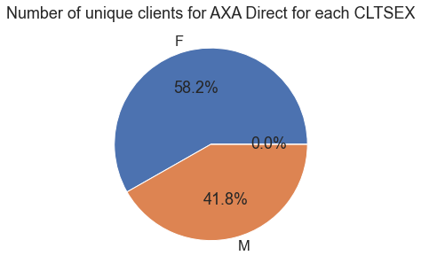
Additional Modified slides

Slide 28
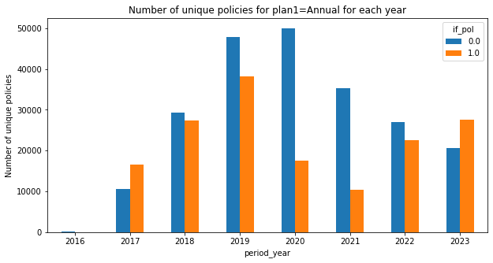
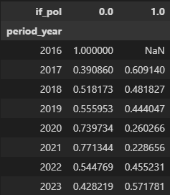
Lapsed/Inforce Count and Ratio for Annual Plan (need to check)
The inforce ratio get’s higher then lapsed ratio in 2017 and 2023
The inforce rate drop drastically from 2020 then gradually increased after 2021.

Slide 29
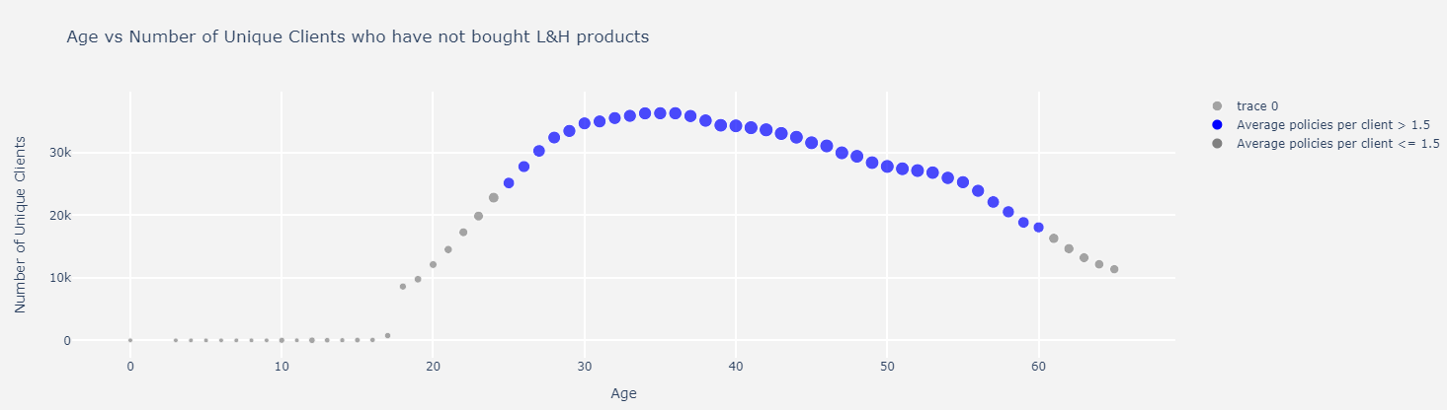
Average policies per client in age

Slide 30

Additional Modified slides

Slide 31
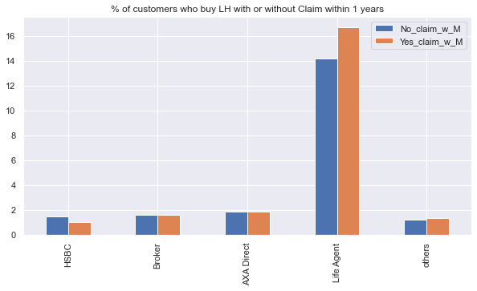
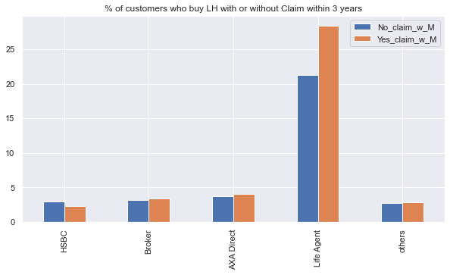
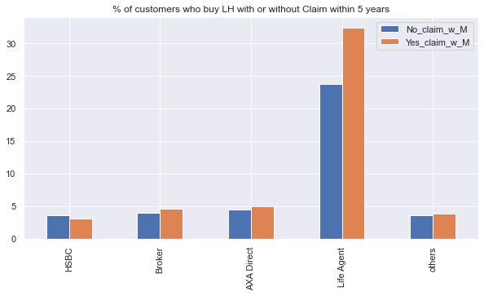
Claim LH effect
Blue= (T&~C&M)/(T&~C)
Blue=D/C
Orange=(T&C&M)/(T&C)
Orange=B/A
Ratio of customers who buy LH after claimed in travel is significantly higher than not claimed in travel.
Except for HSBC, maybe due to lack of agent?

Slide 32
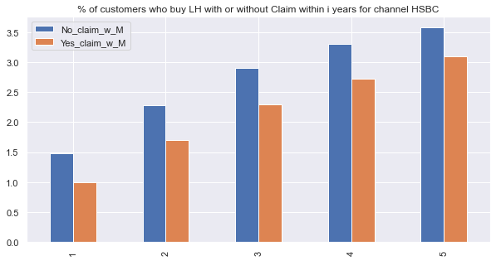
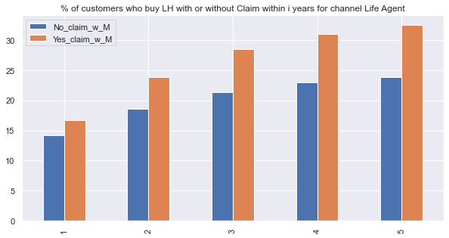
HSBC vs Life Agent

Slide 33
Frequency for travel customers
 |  | 1. PreCovid | 2.Covid | 3.PostCovid
Bought at least 1 time Number_unique_contrnb>=1 | Single | 471338 | 30565 | 3743
 | Annual | 53907 | 11282 | 1076
Bought at least 2 time | Single | 237906 | 3398 | 261
 | Annual | 8662 | 828 | 38
bought >=3 time | Single | 151874 | 620 | 38
 | Annual | 1348 | 99 | 5

Slide 34
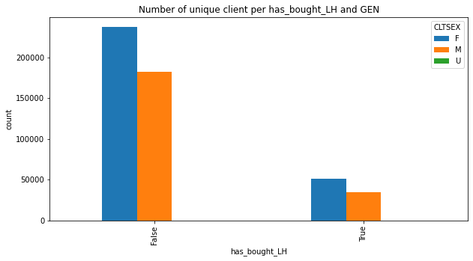


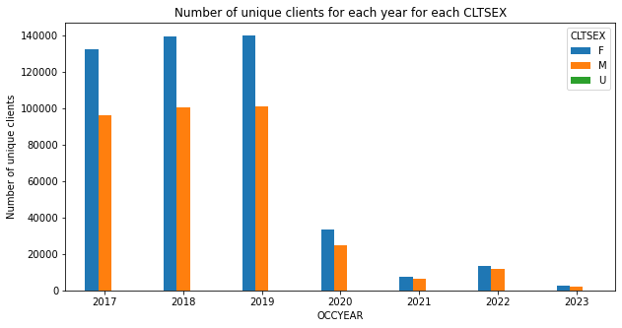
With LH Gender Ratio
Females(blue) are always more aware of insurance then Male.

Slide 35
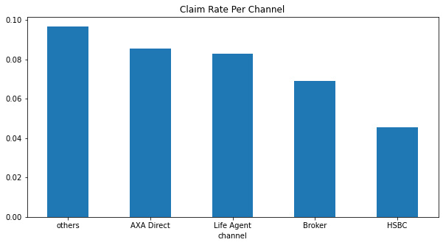
Claim rate

Slide 36
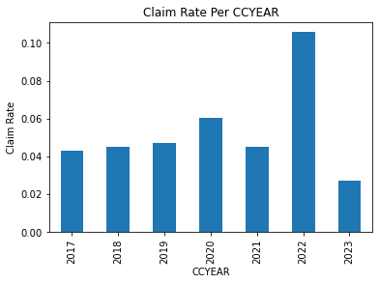
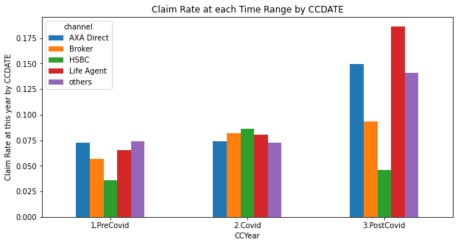
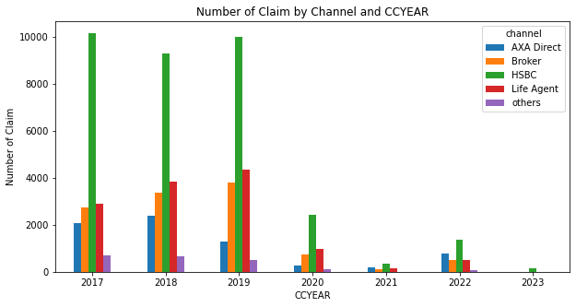
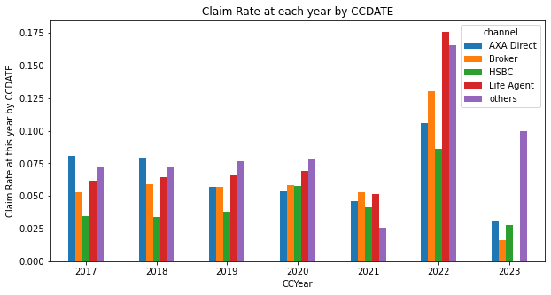

Slide 37




Claim rate of single trip overcomes that of annual trip in 2021.
Claim rate of Annual trip is the highest in 2022.
Overall claim rate is higher during Covid despite the drop in total claim number.

Slide 38
Unique Client Count of bought LH or not
has_bought_LH | count | %
FALSE | 441035 | 83
TRUE | 88232 | 17

Slide 39


Number of unique clients who has bought LH product and the plan types.

Slide 40


Generally, more clients are buying L&H, except for 2018 has a slight drop.

Slide 41


The number of customers buying medical(green) line increased in contrast to other products.
At 2021, more people are buying traditional life(brown).

Slide 42


Most people bought annual trip at 2021
Most travel duration is 4-5 days

Slide 43


First – time –buying –LH-age group distribution.
Since around 2012, the Age group of first-time-buying-LH has most increased in the age group of 17-30, more young people are gaining more awareness on LH insurance products.

Slide 44

Additional Modified slides

Slide 45


Distribution of each unique client’s age when they bought LH for the first time.
Most people first buy L&H product at the age
18
22-26
29-30

Slide 46


Avg premium per year per plan
The average annual premium of traditional life(pink) has increased drastically from 2018.

Slide 47


Total premium per year per type
Total premium of traditional life(pink) has increased from 2018 as well.
Medical(red) increased while critical illness(blue) decreased.
Seems more ppl are buying medical instead of CI.

Slide 48

Total Annual premium VS Number of unique policy number Per year Per Plan Type
The number of policy of medical product is the largest while traditional life is the most profitable product compare both Total premium.

Slide 49



Premium per age group per plan
Term and traditional life are more popular
Old medic is the most profitable product, especially among old people
Traditional life’s profitability is similar in different age-range.

Slide 50


Avg premium per year per age group
Age group of 51-60 has pay more in average in 2020, and return to previous level afterwards.
Age group of 60-61 has increased avg premium at 2019 only.

Slide 51


2019:61-70
2020:51-60

Slide 52
Frequency for Travel + LH Customer
FOR T+LH CUSTOMER |  | 1. PreCovid | 2.Covid | 3.PostCovid
Bought at least 1 time Number_unique_contrnb>=1 | Single | 78576 | 4788 | 393
 | Annual | 11057 | 1626 | 118
Bought at least 2 time | Single | 43718 | 524 | 15
 | Annual | 2269 | 126 | 5
bought >=3 time | Single | 28571 | 79 | 2
 | Annual | 397 | 10 | 1

Slide 53
Knowledge Points
Column ‘plan 1’ is indicating single/annual trip
paymnt_g is being used, not paymnt_n(told by Travel Team)
Use If_pol + period to check if the contract is inforce in that year
CCDATE: renew date , OCCDATE: the date when first buy the policy
DUMMY_ID=['unknown','A123456','F123456’](IDs that I think is not real)
DATREP in claimbase is date of reporting the accident.
There’s some client numbers from basestat are not in cient_base, so I decided to drop all those rows before analysing.
rscd_des in claimbase is the claim type, medical/lost iphone etc

Slide 54
Mapping that I used:
plan1={
'single': 'single',
'Annual': 'Annual',
'Annual/Over 30 Days': 'Annual'
}
modi_channels={
'Banca - HSBC':'HSBC',
'Agents & Broker':'Broker',
'AXA Online Direct':'AXA Direct',
'AXA Offline Direct':'AXA Direct',
'LP':'Life Agent',
'Citi':'others',
'JLT (OSC)': 'others'
}
CURRENCY_CHANGE_RATE_TO_HKD={
"AUD": 6.66,
"CAD": 6.66,
"CHF": 5.71,
"EUR": 8.0,
"USD": 8.0,
"SGD": 5.0,
"NZD":4.44,
"GBP":13.33
}
# generated a new col["ANNUAL_PREM_HKD“] using the CURRENCY_CHANGE_RATE_TO_HKD dict and CURRENCY and ANNUAL_PREM_EXCLUDE_TOPUP_REGULAR
# if CURRENCY is in the dict, then use the value in the dict to multiply ANNUAL_PREM_EXCLUDE_TOPUP_REGULAR
# if CURRENCY is not in the dict, then use 1 to multiply ANNUAL_PREM_EXCLUDE_TOPUP_REGULAR

